Slide 1
Web Programming 06016322
By Dr Bundit Thanasopon

Slide 2
Javascript Revision
SRC: https://www.w3schools.com/js/default.asp

Slide 3

Examples of what JavaScript can do
Change
JavaScript Can Change HTML Content
document.getElementById("demo").innerHTML = "Hello JavaScript";
Change
JavaScript Can Change HTML Attribute Values
document.getElementById(”myImage").src = "hello.jpg";
Change
JavaScript Can Change HTML Styles (CSS)
document.getElementById("demo").style.fontSize = "35px";
Create
JavaScript Can Create HTML Elements
Remove
Javascript Can Remove HTML Elements

Slide 4
The <script> Tag
Scripts can be placed in the <body>, or in the <head> section of an HTML page, or in both.
<script> function myFunction() { document.getElementById("demo").innerHTML = "Paragraph changed."; } </script>
External JavaScript
<script src="myScript.js"></script>

Slide 5
External JavaScript Advantages
Placing scripts in external files has some advantages:
It separates HTML and code
It makes HTML and JavaScript easier to read and maintain
Cached JavaScript files can speed up page loads
To add several script files to one page - use several script tags:
<script src="myScript1.js"></script> <script src="myScript2.js"></script>

Slide 6
JavaScript Output
JavaScript can "display" data in different ways:
Writing into an HTML element, using innerHTML.
Writing into the HTML output using document.write().
Writing into an alert box, using window.alert().
Writing into the browser console, using console.log().
<h1>My First Web Page</h1> <p>My first paragraph.</p> <script> document.write(5 + 6); </script>
Notes:
coding.png

Slide 7
JavaScript Keywords
Keyword | Description
break | Terminates a switch or a loop
continue | Jumps out of a loop and starts at the top
debugger | Stops the execution of JavaScript, and calls (if available) the debugging function
do ... while | Executes a block of statements, and repeats the block, while a condition is true
for | Marks a block of statements to be executed, as long as a condition is true
function | Declares a function
if ... else | Marks a block of statements to be executed, depending on a condition
return | Exits a function
switch | Marks a block of statements to be executed, depending on different cases
try ... catch | Implements error handling to a block of statements
var | Declares a variable

Slide 8
Javascript Syntax
JavaScript Identifiers
Identifiers are names.
In JavaScript, identifiers are used to name variables (and keywords, and functions, and labels).
In JavaScript, the first character must be a letter, or an underscore (_), or a dollar sign ($).
JavaScript is Case Sensitive
All JavaScript identifiers are case sensitive.
The variables lastName and lastname, are two different variables
JavaScript Comments
Code after double slashes // or between /* and */ is treated as a comment.

Slide 9
Javascript Operators
Operator | Description
== | Equal to
=== | Equal value and equal type
!= | Not equal
!== | Not equal value or not equal type
> | Greater than
< | Less than
>= | Greater than or equal to
<= | Less than or equal to
? | Ternary operator
&& | Logical and
|| | Logical or
! | Logical not
Operator | Description
+ | Addition
- | Subtraction
* | Multiplication
** | Exponentiation (ES6)
/ | Division
% | Modulus (Division Remainder)
++ | Increment
-- | Decrement

Slide 10
Javascript Data Types – primitive data
JavaScript Types are Dynamic - this means that the same variable can be used to hold different data types:
let x; // Now x is undefined x = 5; // Now x is a Number x = "John"; // Now x is a String
A primitive data value is a single simple data value with no additional properties and methods.
The typeof operator can return one of these primitive types:
string
number
boolean (true or false)
undefined

Slide 11
Javascript Data Types complex data
Complex Data
The typeof operator can return one of two complex types:
function
object
The typeof operator returns object for both objects, arrays, and null.
The typeof operator return “ function” for functions.
typeof {name:'John', age:34}
// Returns "object" typeof [1,2,3,4]
// Returns "object" typeof null
// Returns "object" typeof function myFunc(){}
// Returns "function"
The typeof operator returns "object" for arrays because in JavaScript arrays are objects.
Notes:
SHOW in CONSOLE

Slide 12
Javascript Functions
A JavaScript function is a block of code designed to perform a particular task.
A JavaScript function is executed when "something" invokes it (calls it).
function myFunction(p1, p2) { return p1 * p2; // The function returns the product of p1 and p2 }
The () Operator Invokes the Function
toCelsius refers to the function object, and toCelsius() refers to the function result.
Accessing a function without () will return the function definition instead of the function result:
function toCelsius(fahrenheit) { return (5/9) * (fahrenheit-32); } document.getElementById("demo").innerHTML = toCelsius;

Slide 13
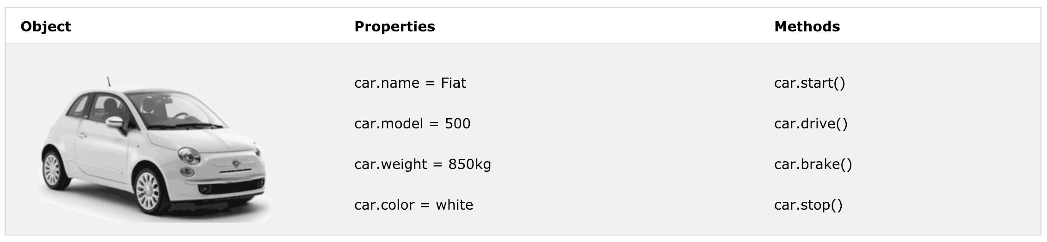
JavaScript Objects
What is an object? In real life, a car is an object. A car has properties like weight and color, and methods like start and stop:
All cars have the same properties, but the property values differ from car to car.
All cars have the same methods, but the methods are performed at different times.

Slide 14
JavaScript Objects
var person = { firstName: "John", lastName : "Doe", id : 5566, fullName : function() { return this.firstName + " " + this.lastName; } };
In a function definition, this refers to the "owner" of the function.
In the example above, this is the person object that "owns" the fullName function.
In other words, this.firstName means the firstName property of this object.

Slide 15
JavaScript Events
HTML events are "things" that happen to HTML elements.
When JavaScript is used in HTML pages, JavaScript can "react" on these events.
An HTML event can be something the browser does, or something a user does.
Here are some examples of HTML events:
An HTML web page has finished loading
An HTML input field was changed
An HTML button was clicked
Often, when events happen, you may want to do something. JavaScript lets you execute code when events are detected.

Slide 16
Common HTML Events
Event | Description
onchange | An HTML element has been changed
onclick | The user clicks an HTML element
onmouseover | The user moves the mouse over an HTML element
onmouseout | The user moves the mouse away from an HTML element
onkeydown | The user pushes a keyboard key
onload | The browser has finished loading the page
Notes:
Show intro.html SOURCE CODE

Slide 17
Adding Event Listeners
<button id="btn1">Click me</button>
<button id="btn2">Act-once button</button>
<script>
let button1 = document.getElementById(“btn1");
button1.addEventListener("click", () => {
console.log("Button clicked.");
});
let button2 = document.getElementById(“btn2");
function once() {
console.log("Done.");
button2.removeEventListener("click", once);
}
button2.addEventListener("click", once);
</script>

Slide 18
LeT’s Do some Exercises
Complete exercise 1 - 3

Slide 19
Javascript Array

Slide 20
JavaScript Arrays
An array is a special variable, which can hold more than one value at a time.
var cars = ["Saab", "Volvo", "BMW"];
You access an array element by referring to the index number.
var name = cars[0];
This statement changes the value of the first element in cars:
cars[0] = "Opel";

Slide 21
JavaScript Array Iteration Methods - foreach
The forEach() method calls a function (a callback function) once for each array element.
var txt = ""; var numbers = [45, 4, 9, 16, 25]; numbers.forEach(myFunction); function myFunction(value, index, array) { txt = txt + value + "<br>"; }
Note that the function takes 3 arguments:
The item value
The item index
The array itself

Slide 22
JavaScript Array Iteration Methods - MAP
The map() method creates a new array by performing a function on each array element.
The map() method does not execute the function for array elements without values.
The map() method does not change the original array.
This example multiplies each array value by 2:
var numbers1 = [45, 4, 9, 16, 25]; var numbers2 = numbers1.map(myFunction); function myFunction(value, index, array) { return value * 2; }

Slide 23
JavaScript Array Iteration Methods - Filter
The filter() method creates a new array with array elements that passes a test.
This example creates a new array from elements with a value larger than 18:
var numbers = [45, 4, 9, 16, 25]; var over18 = numbers.filter(myFunction); function myFunction(value, index, array) { return value > 18; }

Slide 24
JavaScript Array Iteration Methods - Reduce
The reduce() method runs a function on each array element to produce (reduce it to) a single value.
The reduce() method works from left-to-right and does not reduce the original array.
This example finds the sum of all numbers in an array:
var numbers1 = [45, 4, 9, 16, 25]; var sum = numbers1.reduce(myFunction);
function myFunction(total, value, index, array) { return total + value; }
Note that the function takes 4 arguments:
The total (the initial value / previously returned value)
The item value
The item index
The array itself

Slide 25
var sum = numbers1.reduce(myFunction);
Loop 2
total = 49
value = 9
Loop 4
total = 74
value = 25
99
[ 45 , 4 , 9 , 16 , 25 ]
Loop 1
total = 45
value = 4
Loop 3
total = 58
value = 16

Slide 26
var sum = numbers1.reduce(myFunction, 5);
Loop 1
total = 5
value = 45
Loop 3
total = 54
value = 9
Loop 5
total = 79
value = 25
104
[ 45 , 4 , 9 , 16 , 25 ]
Loop 2
total = 50
value = 4
Loop 4
total = 63
value = 16

Slide 27
JavaScript Array Iteration Methods - Indexof
The indexOf() method searches an array for an element value and returns its position.
Note: The first item has position 0, the second item has position 1, and so on.
var fruits = ["Apple", "Orange", "Apple", "Mango"]; var a = fruits.indexOf("Apple");
Array.lastIndexOf() is the same as Array.indexOf(), but searches from the end of the array.

Slide 28
SPLICE
The splice() method adds/removes items to/from an array, and returns the removed item(s).
array.splice(index, howmany, item1, ....., itemX)
Parameter | Description
index | Required. An integer that specifies at what position to add/remove items, Use negative values to specify the position from the end of the array
howmany | Optional. The number of items to be removed. If set to 0, no items will be removed
item1, ..., itemX | Optional. The new item(s) to be added to the array
var fruits = ["Banana", "Orange", "Apple", "Mango"]; fruits.splice(2, 1, "Lemon", "Kiwi");

Slide 29
LeT’s Do some Exercises
Complete exercise 4 - 5

Slide 30
JavaScript Cookies
Cookies are data, stored in small text files, on your computer.
When a web server has sent a web page to a browser, the connection is shut down, and the server forgets everything about the user - stateless
Cookies were invented to solve the problem "how to remember information about the user":
When a user visits a web page, his name can be stored in a cookie.
Next time the user visits the page, the cookie "remembers" his name.
When a browser requests a web page from a server, cookies belonging to the page is added to the request. This way the server gets the necessary data to "remember" information about users.

Slide 31
Create a Cookie with JavaScript
JavaScript can create, read, and delete cookies with the ”document.cookie” property.
Create
document.cookie = "username=John Doe; expires=Thu, 18 Dec 2013 12:00:00 UTC";
Read
var x = document.cookie;
Delete
document.cookie = "username=; expires=Thu, 01 Jan 1970 00:00:00 UTC; path=/;";
TRY this js library: https://github.com/js-cookie/js-cookie
Notes:
Path => With a path parameter, you can tell the browser what path the cookie belongs to. By default, the cookie belongs to the current page.

Slide 32
Window localStorage Property
The localStorage and sessionStorage properties allow to save key/value pairs in a web browser.
The localStorage object stores data with no expiration date. The data will not be deleted when the browser is closed, and will be available the next day, week, or year.
The localStorage property is read-only.
localStorage.setItem("key", "value");
var lastname = localStorage.getItem("key");
localStorage.removeItem("key");

Slide 33
The HTML DOM
(Document Object Model)

Slide 34
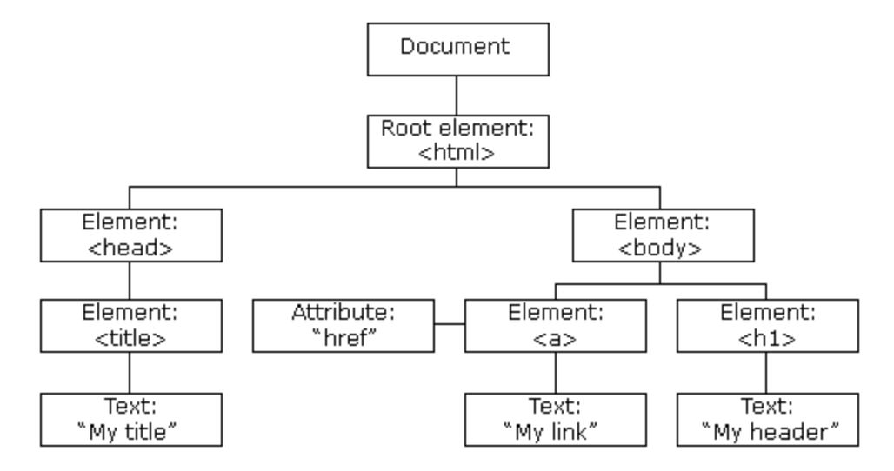
The HTML DOM
With the HTML DOM, JavaScript can access and change all the elements of an HTML document.
When a web page is loaded, the browser creates a Document Object Model of the page.
The HTML DOM model is constructed as a tree of Objects:

Slide 35
What can Javascript do with the HTML DOM?
With the object model, JavaScript gets all the power it needs to create dynamic HTML:
JavaScript can change all the HTML elements in the page
JavaScript can change all the HTML attributes in the page
JavaScript can change all the CSS styles in the page
JavaScript can remove existing HTML elements and attributes
JavaScript can add new HTML elements and attributes
JavaScript can react to all existing HTML events in the page
JavaScript can create new HTML events in the page

Slide 36
The DOM Programming Interface
The HTML DOM can be accessed with JavaScript (and with other programming languages).
In the DOM, all HTML elements are defined as objects.
A property is a value that you can get or set (like changing the content of an HTML element).
A method is an action you can do (like add or deleting an HTML element).
document.getElementById("demo").innerHTML = "Hello World!";
In the example above, getElementById is a method, while innerHTML is a property.

Slide 37
The HTML DOM Document Object
The document object represents your web page.
If you want to access any element in an HTML page, you always start with accessing the document object.
Finding HTML Elements
Method | Description
document.getElementById(id) | Find an element by element id
document.getElementsByTagName(name) | Find elements by tag name
document.getElementsByClassName(name) | Find elements by class name
document.querySelector(selectors) | Find an element by css selector
document.querySelectorAll(selectors) | Find elements by css selector

Slide 38
Changing HTML Elements
Method | Description
element.innerHTML = new html content | Change the inner HTML of an element
element.attribute = new value | Change the attribute value of an HTML element
element.setAttribute(attribute, value) | Change the attribute value of an HTML element
element.style.property = new style | Change the style of an HTML element

Slide 39
Adding and Deleting Elements
Method | Description
document.createElement(element) | Create an HTML element
document.removeChild(element) | Remove an HTML element
document.appendChild(element) | Add an HTML element
document.replaceChild(element) | Replace an HTML element
document.write(text) | Write into the HTML output stream

Slide 40
JavaScript HTML DOM Events
A JavaScript can be executed when an event occurs, like when a user clicks on an HTML element.
Examples of HTML events:
When a user clicks the mouse
When a web page has loaded
When an image has been loaded
When the mouse moves over an element
When an input field is changed
When an HTML form is submitted
When a user strokes a key
<h1 onclick="changeText(this)">Click on this text!</h1>

Slide 41
JavaScript HTML DOM EventListener
document.getElementById("myBtn").addEventListener("click", displayDate);
The addEventListener() method attaches an event handler to the specified element.
The addEventListener() method allows you to add event listeners on any HTML DOM object such as HTML elements, the HTML document, the window object.
The removeEventListener() method removes event handlers that have been attached with the addEventListener() method:
element.removeEventListener("mousemove", myFunction);

Slide 42
JavaScript HTML DOM Navigation
According to the W3C HTML DOM standard, everything in an HTML document is a node:
The entire document is a document node
Every HTML element is an element node
The text inside HTML elements are text nodes
All comments are comment nodes
With the HTML DOM, all nodes in the node tree can be accessed by JavaScript.
New nodes can be created, and all nodes can be modified or deleted.

Slide 43
Node Relationships
The nodes in the node tree have a hierarchical relationship to each other.
The terms parent, child, and sibling are used to describe the relationships.
In a node tree, the top node is called the root (or root node)
Every node has exactly one parent, except the root (which has no parent)
A node can have a number of children
Siblings (brothers or sisters) are nodes with the same parent

Slide 44
Node Relationships
<html> <head> <title>DOM Tutorial</title> </head> <body> <h1>DOM Lesson one</h1> <p>Hello world!</p> </body> </html>
<html> is the root node
<html> has no parents
<html> is the parent of <head> and <body>
<head> is the first child of <html>
<body> is the last child of <html>
<head> has one child: <title>
<title> has one child (a text node): "DOM Tutorial"
<body> has two children: <h1> and <p>
<h1> has one child: "DOM Lesson one"
<p> has one child: "Hello world!"
<h1> and <p> are siblings

Slide 45
Navigating Between Nodes
You can use the following node properties to navigate between nodes with JavaScript:
parentNode
childNodes[nodenumber]
firstChild
lastChild
nextSibling
previousSibling
The nodeName property specifies the name of a node.
The nodeValue property specifies the value of a node.
The nodeType property is read only. It returns the type of a node.

Slide 46
LeT’s Do some Exercises
Complete exercise 6-9

